Slide 1

HAWKES PROCESS
VIETNAM GENERAL CONFEDERATION OF LABOUR
TON DUC THANG UNIVERSITY
FACULTY OF MATHEMATICS AND STATISTICS
Teacher: Dr. Nguyen Chi Thien
Student: Phan Lien Hong Mai – 186007003
Do Thi Thanh Thu – 186007004

Slide 2


BACKGROUND
HAWKES PROCESS
HAWKES PROCESS
APPLICATION

Slide 3
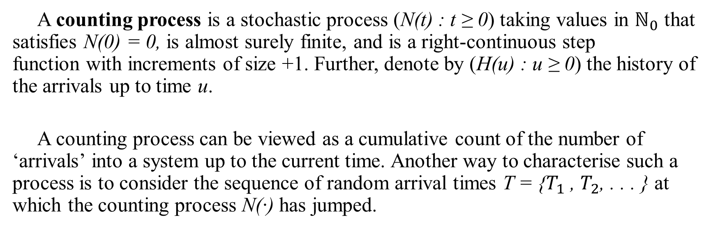
Definition 1 (Counting Process)
Hawkes Process
A counting process is a stochastic process (N(t) : t ≥ 0) taking values in $ℕ_{0}$ that satisfies N(0) = 0, is almost surely finite, and is a right-continuous step function with increments of size +1. Further, denote by (H(u) : u ≥ 0) the history of the arrivals up to time u.
A counting process can be viewed as a cumulative count of the number of ‘arrivals’ into a system up to the current time. Another way to characterise such a process is to consider the sequence of random arrival times T = {$T_{1}$ , $T_{2}$, . . . } at which the counting process N(·) has jumped.

Slide 4
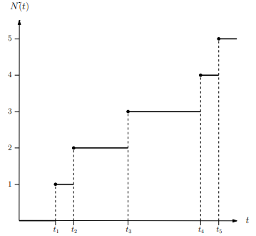
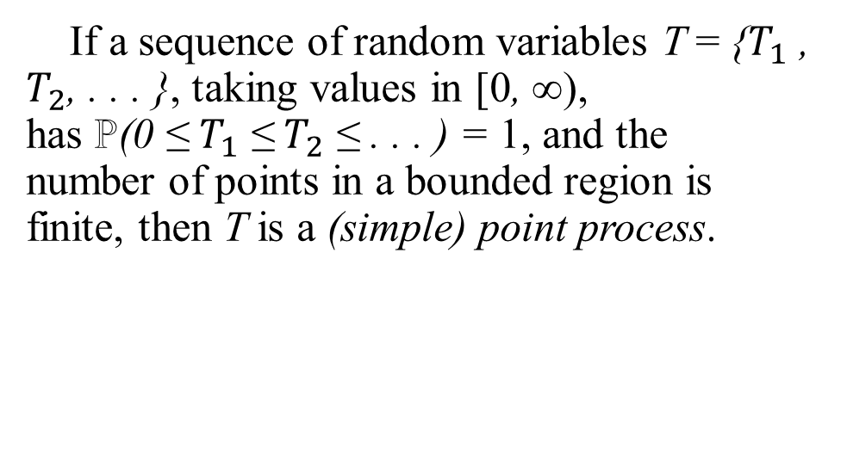
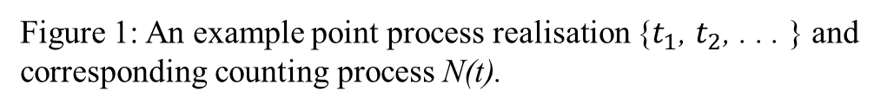
Definition 2 (Point Process)
Hawkes Process
If a sequence of random variables T = {$T_{1}$ , $T_{2}$, . . . }, taking values in [0, ∞), has ℙ(0 ≤ $T_{1}$ ≤ $T_{2}$ ≤ . . . ) = 1, and the number of points in a bounded region is finite, then T is a (simple) point process.
Figure 1: An example point process realisation {$t_{1}$, $t_{2}$, . . . } and corresponding counting process N(t).

Slide 5
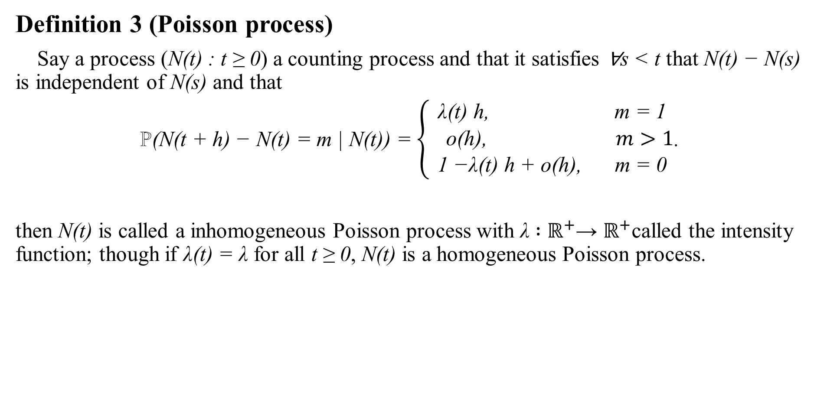
Hawkes Process
Definition 3 (Poisson process)
Say a process (N(t) : t ≥ 0) a counting process and that it satisfies ∀s < t that N(t) − N(s) is independent of N(s) and that
ℙ(N(t + h) − N(t) = m | N(t)) = $\left\{\begin{aligned}\text{λ}\text{(}\text{t}\text{) }\text{h}\text{, }\text{m}\text{ = 1} \\ \text{o}\text{(}\text{h}\text{),} m>1 \\ \text{1 −}\text{λ}\text{(}\text{t}\text{) }\text{h}\text{ + }\text{o}\text{(}\text{h}\text{), } \text{m}\text{ = 0}\end{aligned}\right.$.
then N(t) is called a inhomogeneous Poisson process with λ ∶ $ℝ^{+}$→ $ℝ^{+}$called the intensity function; though if λ(t) = λ for all t ≥ 0, N(t) is a homogeneous Poisson process.

Slide 6
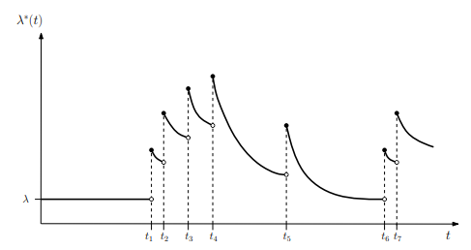
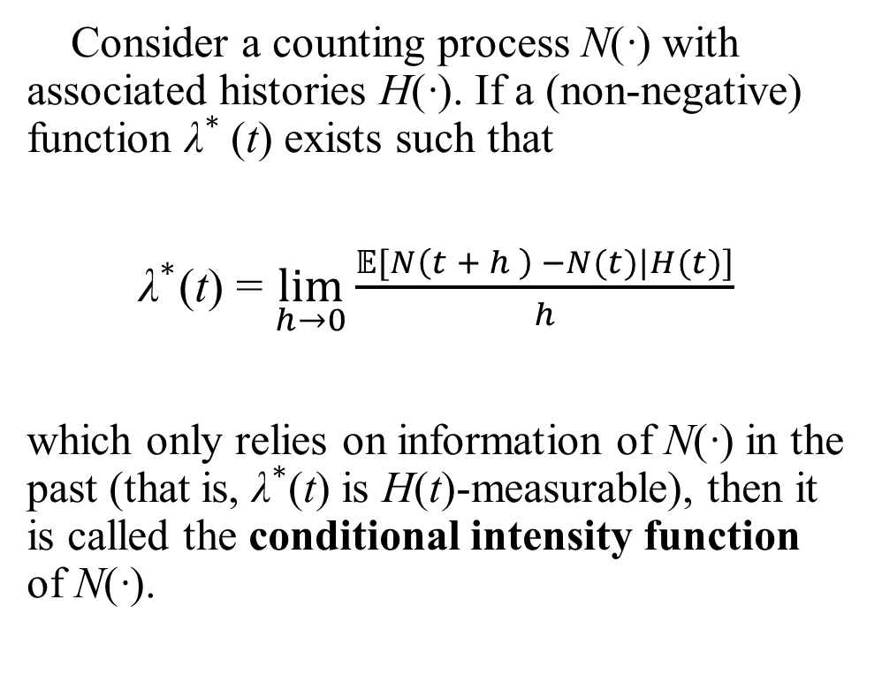
Definition 4 (Conditional intensity function)
Hawkes Process
Consider a counting process N(·) with associated histories H(·). If a (non-negative) function ${\text{λ}}^{∗}$(t) exists such that
${\text{λ}}^{∗}\text{(}\text{t}\text{)}$ = $\lim_{h→0}{\frac{𝔼[N\left(t + h \right) −N(t)|H(t)]}{h}}$
which only relies on information of N(·) in the past (that is, ${\text{λ}}^{∗}$(t) is $\text{H}$(t)-measurable), then it is called the conditional intensity function of N(·).
Figure 2: An example ${\text{λ}}^{∗}\text{(}\text{t}\text{)}$ for a self-exciting process.

Slide 7

Definition 5 (Compensator)
Hawkes Process
For a counting process N(·) the non-decreasing function
Λ(t) = $\int_{0}^{t}{{\text{λ}}^{∗}\left(s\right)ds}$
is called the compensator of the counting process.

Slide 8
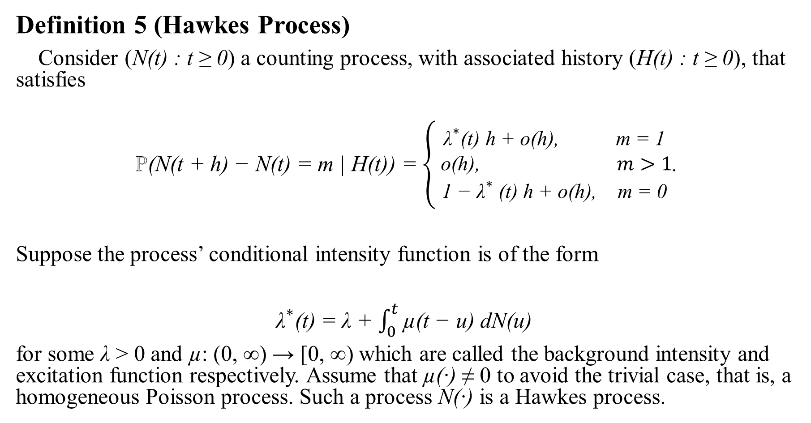
Hawkes Process
Definition 5 (Hawkes Process)
Consider (N(t) : t ≥ 0) a counting process, with associated history (H(t) : t ≥ 0), that satisfies
ℙ(N(t + h) − N(t) = m | H(t)) = $\left\{\begin{aligned}{\text{λ}}^{∗}\text{(}\text{t}\text{) }\text{h}\text{ + }\text{o}\text{(}\text{h}\text{),} \text{m}\text{ = 1} \\ \text{o}\text{(}\text{h}\text{),} m>1 \\ \text{1 − }{\text{λ}}^{∗}\text{ (}\text{t}\text{) }\text{h}\text{ + }\text{o}\text{(}\text{h}\text{), } \text{m}\text{ = 0}\end{aligned}\right.$.
Suppose the process’ conditional intensity function is of the form
${\text{λ}}^{∗}\text{(}\text{t}\text{) }$= λ + $\int_{0}^{t}{\text{µ(}\text{t}\text{ − }\text{u}\text{) }\text{dN}\text{(}\text{u}\text{)} }$
for some λ > 0 and µ: (0, ∞) → [0, ∞) which are called the background intensity and excitation function respectively. Assume that µ(·) ≠ 0 to avoid the trivial case, that is, a homogeneous Poisson process. Such a process N(·) is a Hawkes process.

Slide 9
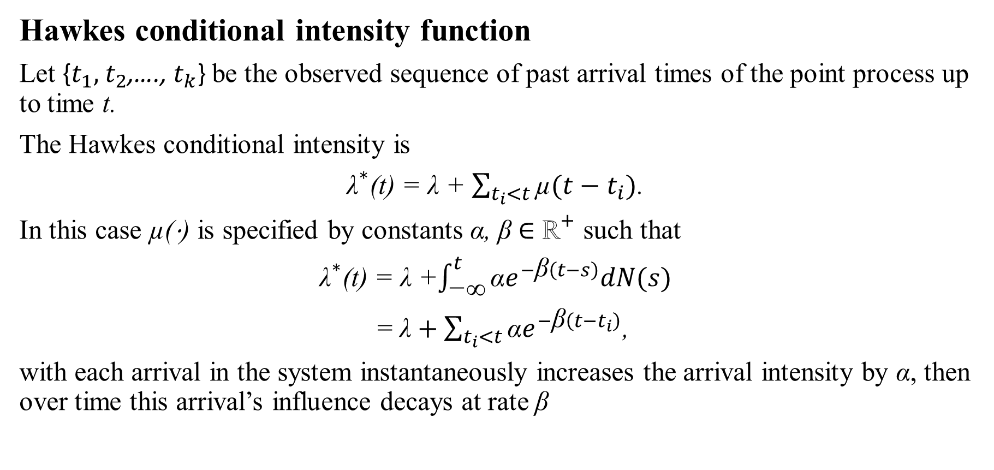
Hawkes Process
Hawkes conditional intensity function
Let {$t_{1},$ $t_{2}$,…., $t_{k}$} be the observed sequence of past arrival times of the point process up to time t.
The Hawkes conditional intensity is
${\text{λ}}^{∗}\text{(}\text{t}\text{)}$ = $\text{λ}$ + $\sum_{t_{i}<t}{\text{µ}(t−t_{i})}$.
In this case µ(⋅) is specified by constants α, β ∈ ${\text{ℝ}}^{+}$ such that
${\text{λ}}^{∗}\text{(}\text{t}\text{)}$ = $\text{λ}$ +$\int_{\text{−∞}}^{t}{\text{α}e^{−\text{β}\left(t−s\right)}dN(s)}$
=$\text{λ}+\sum_{t_{i}<t}{\text{α}e^{−\text{β}\left(t−t_{i}\right)}}$,
with each arrival in the system instantaneously increases the arrival intensity by α, then over time this arrival’s influence decays at rate β

Slide 10
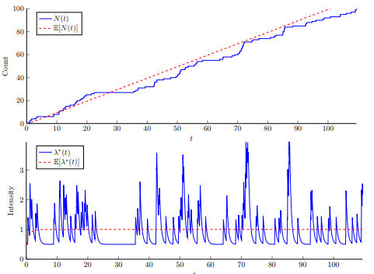
Figure 3: A typical Hawkes process realisation N(t) and associated ${\text{λ}}^{∗}\text{(}\text{t}\text{)}$ plotted against their expected values

Slide 11
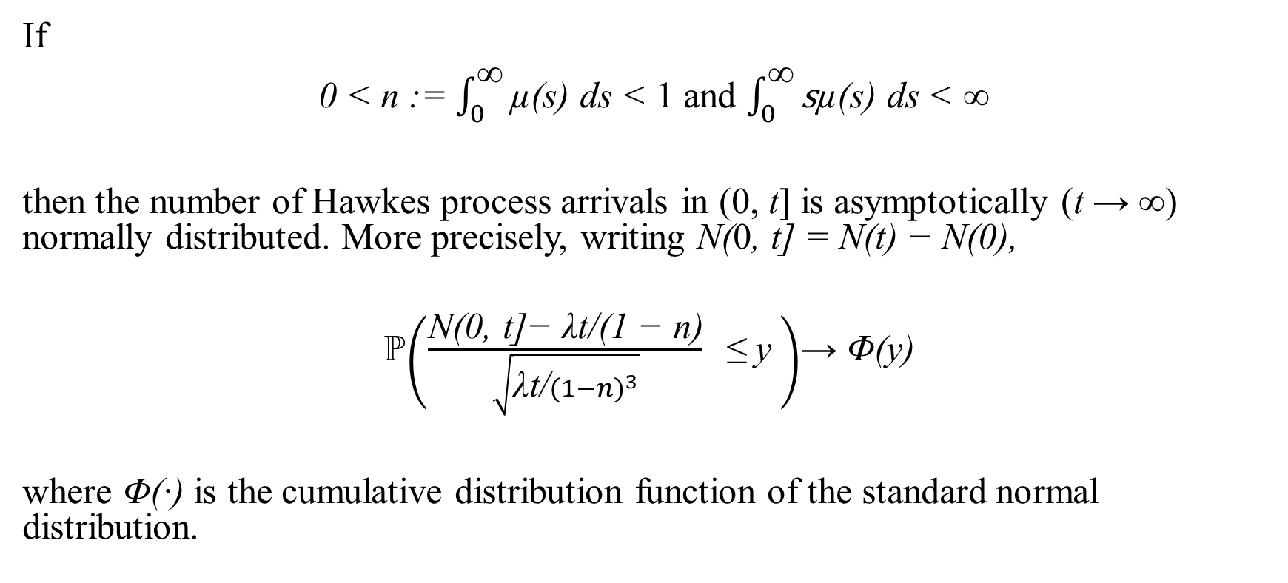
Theorem 1 (Hawkes process asymptotic normality )
Hawkes Process
If
0 < n := $\int_{0}^{\text{∞}}{\text{µ(}\text{s}\text{) }\text{ds}}$ < 1 and $\int_{0}^{\text{∞}}{\text{s}\text{µ(}\text{s}\text{) }\text{ds}}$ < ∞
then the number of Hawkes process arrivals in (0, t] is asymptotically (t → ∞) normally distributed. More precisely, writing N(0, t] = N(t) − N(0),
ℙ$\left(\frac{\text{N}\text{(0, }\text{t}\text{]− }\text{λ}\text{t}\text{/(1 − }\text{n}\text{)}}{\sqrt{\text{λ}\text{t}\text{/}{(1−n)}^{3}}} \text{≤ }\text{y} \right)$→ Φ(y)
where Φ(·) is the cumulative distribution function of the standard normal distribution.

Slide 12
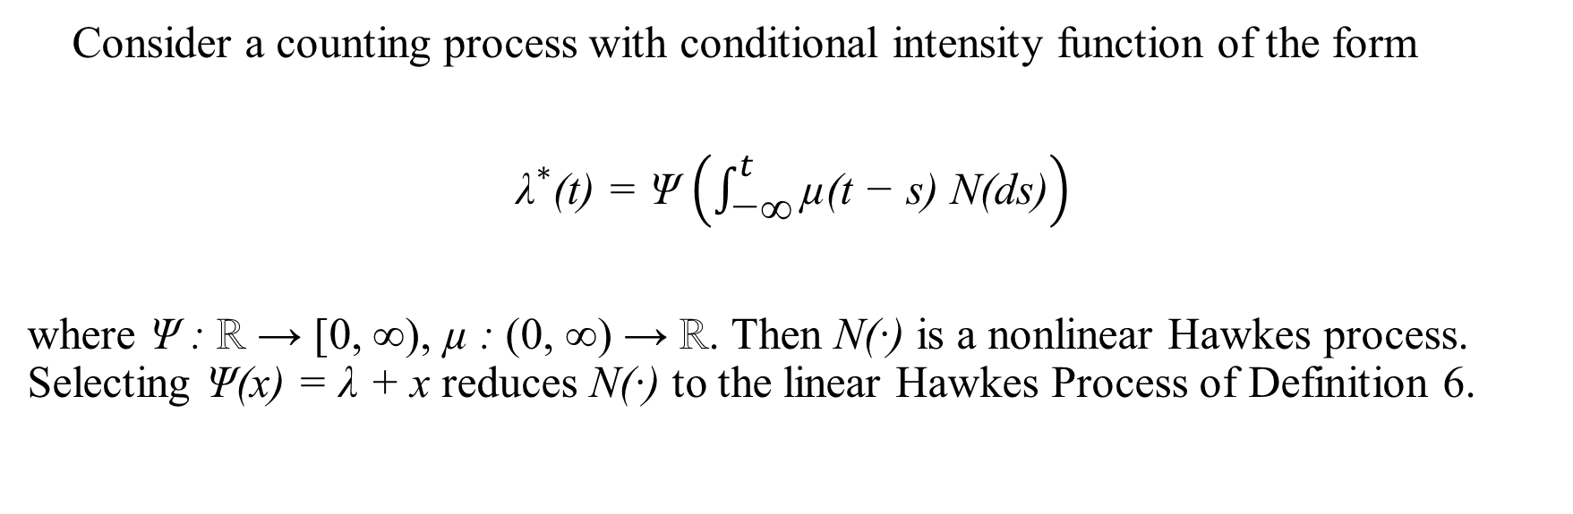
Definition 6 (Nonlinear Hawkes process)
Hawkes Process
Consider a counting process with conditional intensity function of the form
${\text{λ}}^{∗}$(t) = Ψ $\left(\int_{\text{−∞}}^{t}{\text{µ(}\text{t}\text{ − }\text{s}\text{) }\text{N}\text{(}\text{ds}\text{)}}\right)$
where Ψ : ℝ → [0, ∞), µ : (0, ∞) → ℝ. Then N(·) is a nonlinear Hawkes process. Selecting Ψ(x) = λ + x reduces N(·) to the linear Hawkes Process of Definition 6.

Slide 13
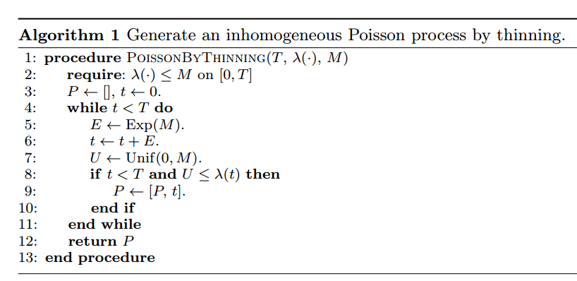
Ogata’s modified thinning algorithm
Hawkes Process

Slide 14
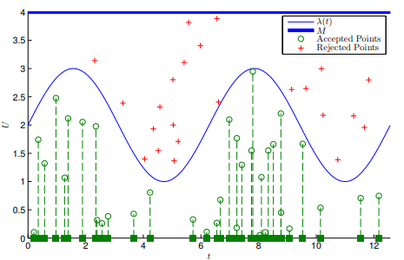
Figure 4: Poisson process

Slide 15
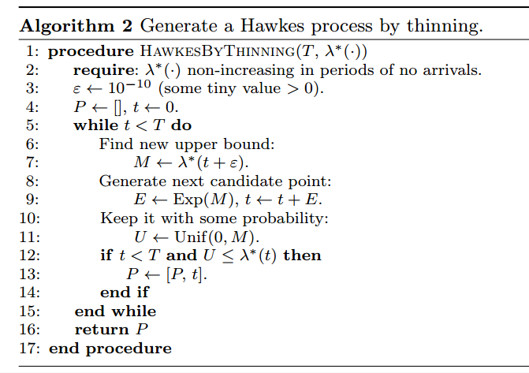
Ogata’s modified thinning algorithm
Hawkes Process

Slide 16
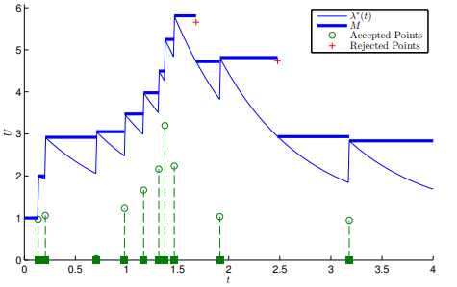
Figure 5: Hawkes process

Slide 17
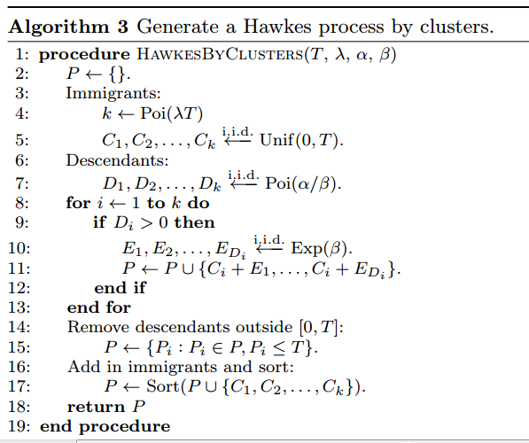
Other methods
Hawkes Process

Slide 18
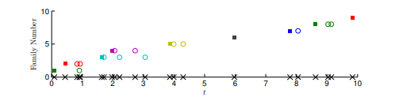
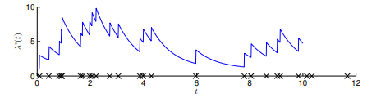
Figure 6.a: The points generated by the immigrant–birth representation
Figure 6.b: The intensity function

Slide 19
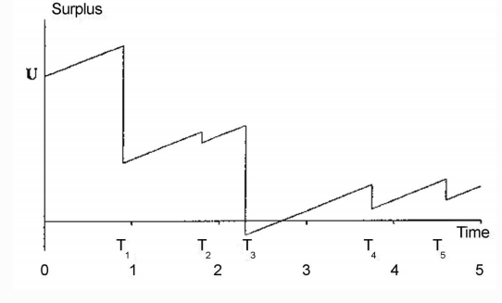
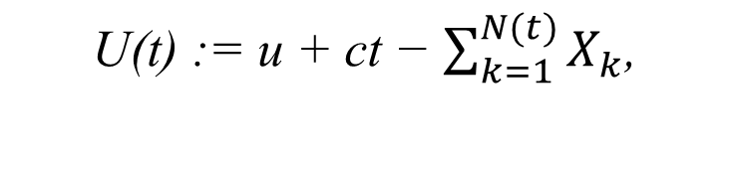
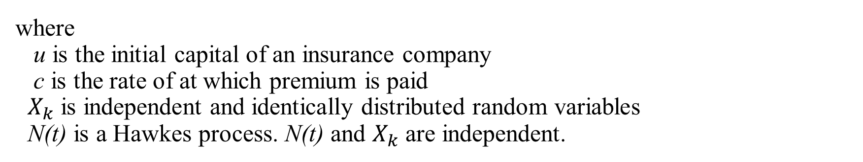
U(t) := u + ct − $\sum_{k=1}^{N(t)}{X_{k}}$,
Hawkes Process
Application in Insurance-Risk Model
The surplus process is written as:
where
u is the initial capital of an insurance company
c is the rate of at which premium is paid
$X_{k}$ is independent and identically distributed random variables
N(t) is a Hawkes process. N(t) and $X_{k}$ are independent.
Figure 7: Insurance-Risk Model

Slide 20
THANK YOU!

